Slide 1
Visual F# Past, Present, and Future
David Stephens
Program Manager
@NumberByColors
daviste@microsoft.com

Slide 2
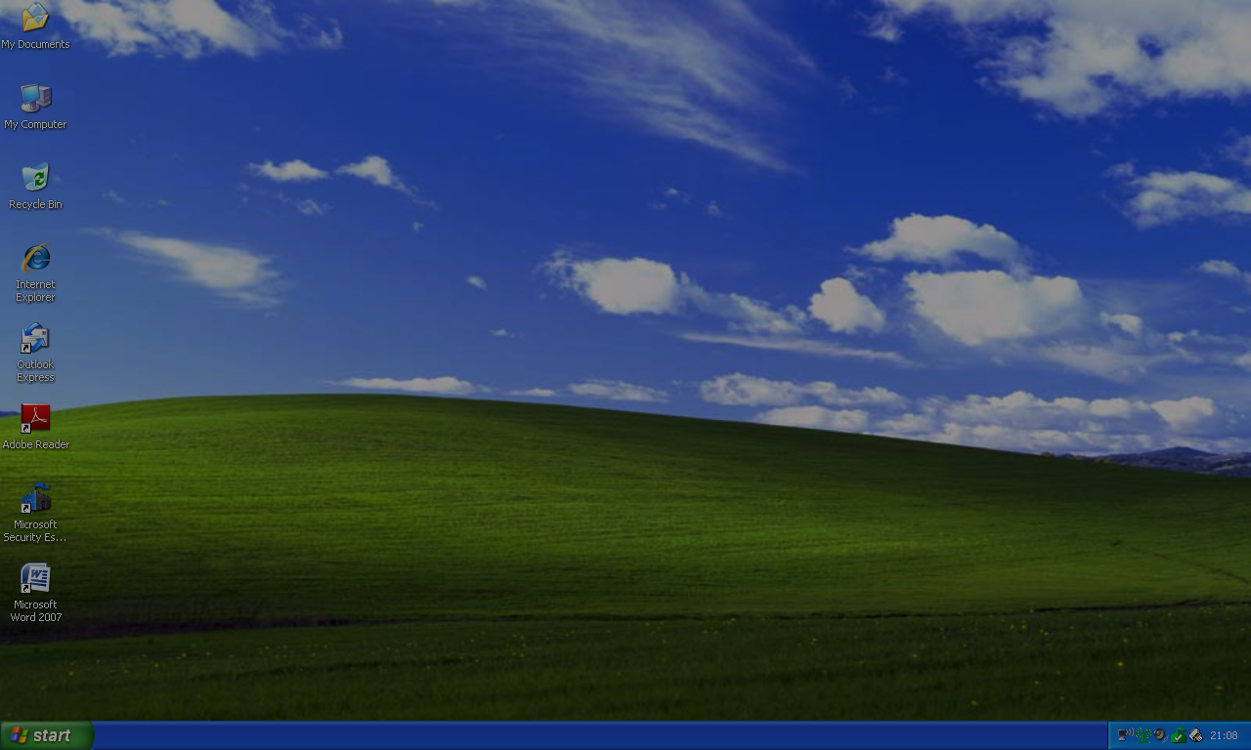
Past

Slide 3
In the Beginning...
fun factorial n = let
fun fac (0, acc) = acc
| fac (n, acc) = fac (n – 1, n * acc)
in
if (n < 0) then raise Fail “negative argument”
else fac (n, 1)
end

Slide 4
Caml
OCaml
F# 1.0
3.0
ML
Haskell
C#
2.0
4.0
1970
1980
1990
2000
2010
2020

Slide 5

F# 1.0 (2005)
“An ML-style language for the .NET platform”
FUNCTIONAL
OOP + INTEROP
Generics
Discriminated unions
Records
Tuples
Lists
Pattern matching
Immutable-by-default
Classes
Structs
Object expressions
Loops
Mutable variables
Inheritance

Slide 6

F# 2.0 (2010)
“Visual Studio 2010 includes the F# language”
FUNCTIONAL
OOP + INTEROP
Active patterns
Units of measure
Computation expressions
Sequence expressions
Async expressions
Array slicing
Code quotations
Extension methods
Named arguments
Optional arguments
Native interop
MailboxProcessor

Slide 7

F# 3.0 (2012)
“Information-rich programming”
FUNCTIONAL
OOP + INTEROP
LINQ expressions
Triple-quoted strings
Named union fields (3.1)
Improved array slicing (3.1)
Type providers
Auto properties

Slide 8
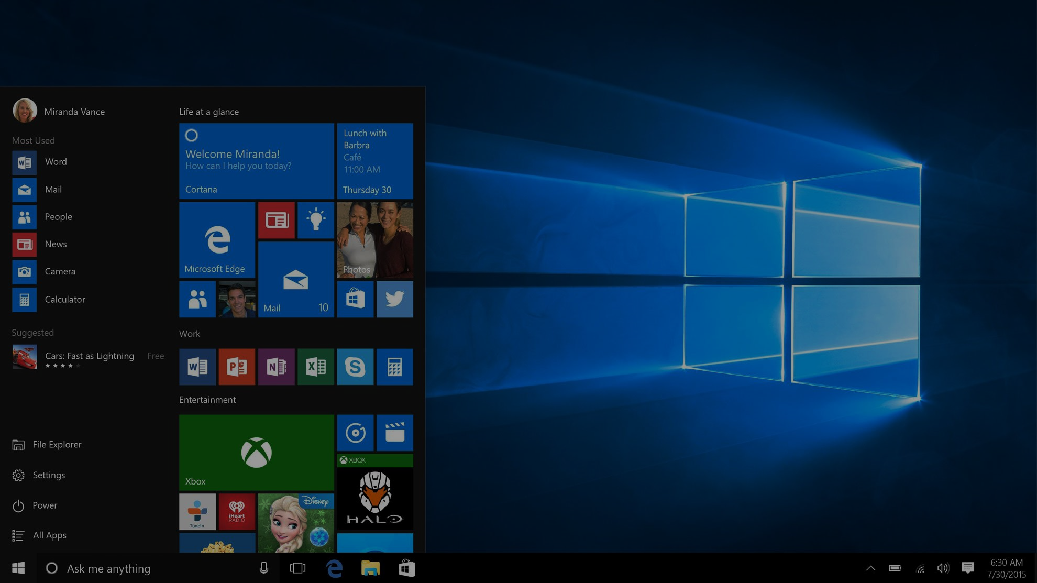
Present

Slide 9

F# 4.0 (2015)
Community contributions:
“A change in culture for the language”
FUNCTIONAL
OOP + INTEROP
Normalized collections APIs
List slicing
First-class constructor functions
High-rank arrays
Rational units of measure exponents
Improved Option API
Automatic mutable/ref conversion
Static parameters for type-provided methods
Non-nullable type-provided types
ReflectedDefinition method arguments

Slide 10
Normalized Collections APIs
// Before
let myList = [0; 1; 2; 3; 4]
let doubledPairs = myList |> List.map (fun x -> x * 2)
|> List.toSeq // ☹
|> Seq.pairwise
|> Seq.toList // [(0, 2); (2, 4); (4, 6); (6, 8)]
// After
let myList = [0; 1; 2; 3; 4]
let doubledPairs = myList |> List.map (fun x -> x * 2)
|> List.pairwise // ☺

Slide 11
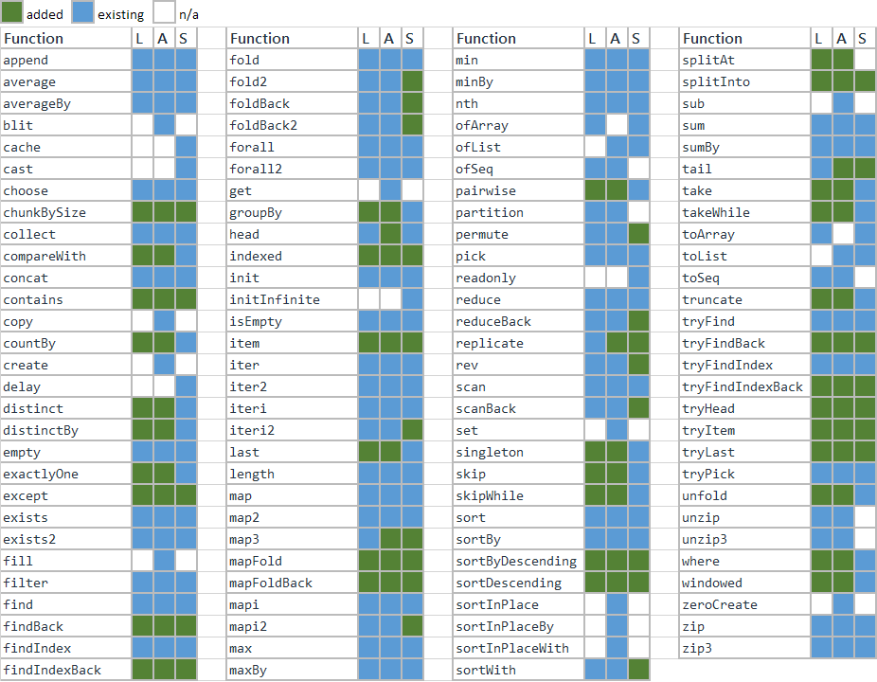

Slide 12
Automatic Mutable/Ref Conversions
// Before
let sumSquares n =
let total = ref 0 // ☹
Seq.iter (fun i -> total := !total + i*i) { 1..n }
!total
// After
let sumSquares n =
let mutable total = 0 // ☺
Seq.iter (fun i -> total <- total + i*i) { 1..n }
total

Slide 13
List Slicing
// Before
let myArr = [| 0; 1; 2; 3; 4 |]
let firstThreeArr = myArr.[0..2] // [| 0; 1; 2 |]
let myList = [0; 1; 2; 3; 4]
let x::y::z::_ = myList // Too clever
let firstThreeList = [x; y; z]
// After
let myList = [0; 1; 2; 3; 4]
let firstThreeList = myList.[0..2] // ☺

Slide 14
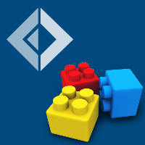













FAKE
Xamarin
Visual F# Power Tools
ProjectScaffold
Check.
Quick
F# Compiler Service
FsCheck
Ionide
WebSharper
Deedle
F# Charting
Suave
Alea GPU
F# Data
Paket
MBrace

Slide 15
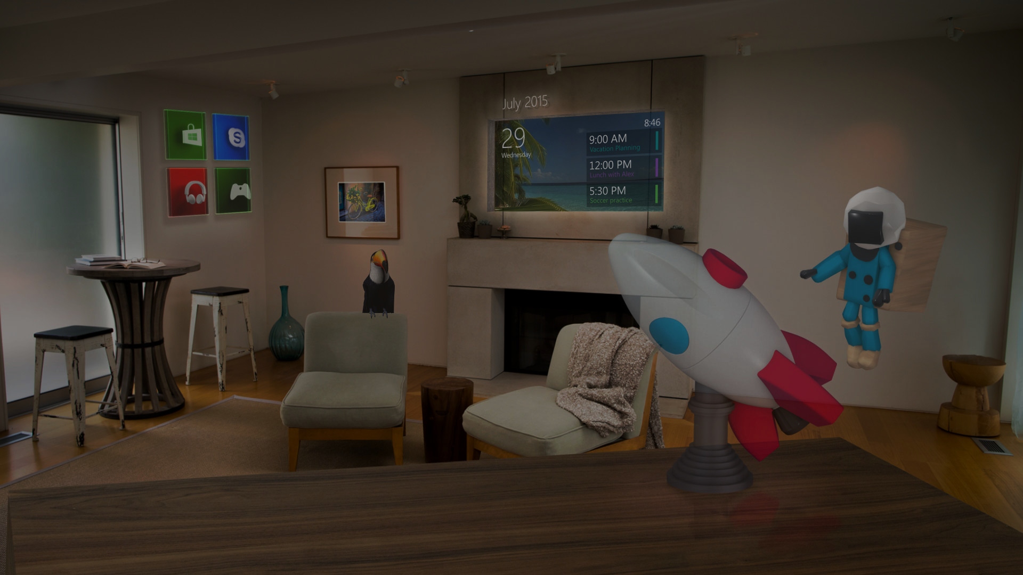
Future

Slide 16

“Stay on the .NET horse”

Slide 17
“Stay on the .NET horse”
.NET Core
.NET Native
Visual Studio Code
More...

Slide 18



.NET 2015
WPF
Windows Forms
ASP.NET (4.X)
ASP.NET 5
Universal Windows Apps
.NET Framework 4.6
.NET Core 5
Common
Runtime Components
Compilers
NuGet packages
Next gen JIT (RyuJIT)
SIMD
Languages innovation
.NET Compiler Platform
.NET Core 5 Libraries
.NET Framework 4.6 Libraries
Notes:
[Transition] Let’s start by showing few of the recent announcements we’ve made on this common area

Slide 19
.NET Core
Cross-platform. “Works on your MacBook.”
Open source. “Jump in on Github.”
Self-contained. “Framework-per-app. Copy to deploy.”
Modular. “Everything is a Nuget package.”
Modernized. “Tidy up after 15 years.”

Slide 20




.NET Core
ASP.NET 5
App Model
Universal Windows Apps Model
Any other
app model
Unified Base Class Library
Runtime Adaption Layer
Core CLR
.NET Native
Other Runtime

Slide 21
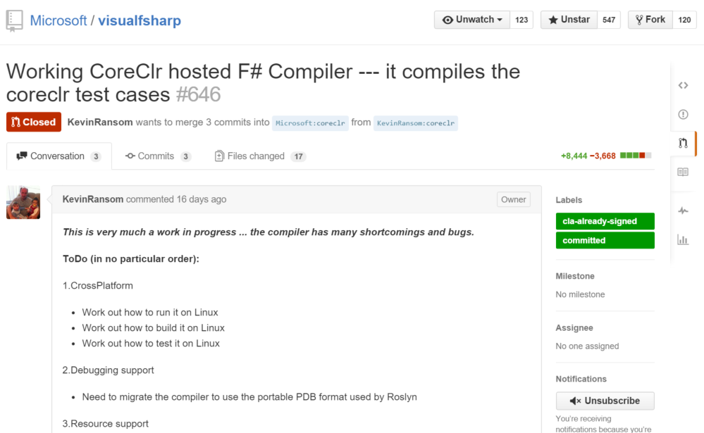

Slide 22
Why does Microsoft contribute to F#?
Support customers and partners using F#
Support teams at Microsoft using F#
Foster the .NET open source ecosystem
Broaden the .NET platform
Facilitate cloud, scientific, numeric, GPU...programming
Participate in programming language research

Slide 23
Questions
tryAnswer: seq<Question> -> seq<Option<Answer>> :
@NumberByColors
daviste@microsoft.com

